Slide 1
Firefly
Year 1 & new parent guide

Slide 2
Firefly is the digital, online learning platform we use across the Prep and the Senior School.
In the Prep school, we predominantly use it to:
Set homework
Provide teacher contact information
Display notices (class specific/ competitions and events)
Show off our learning through photos
Link to external platforms our pupils use
Link to reports and parent’s evening
and much more!

Slide 3
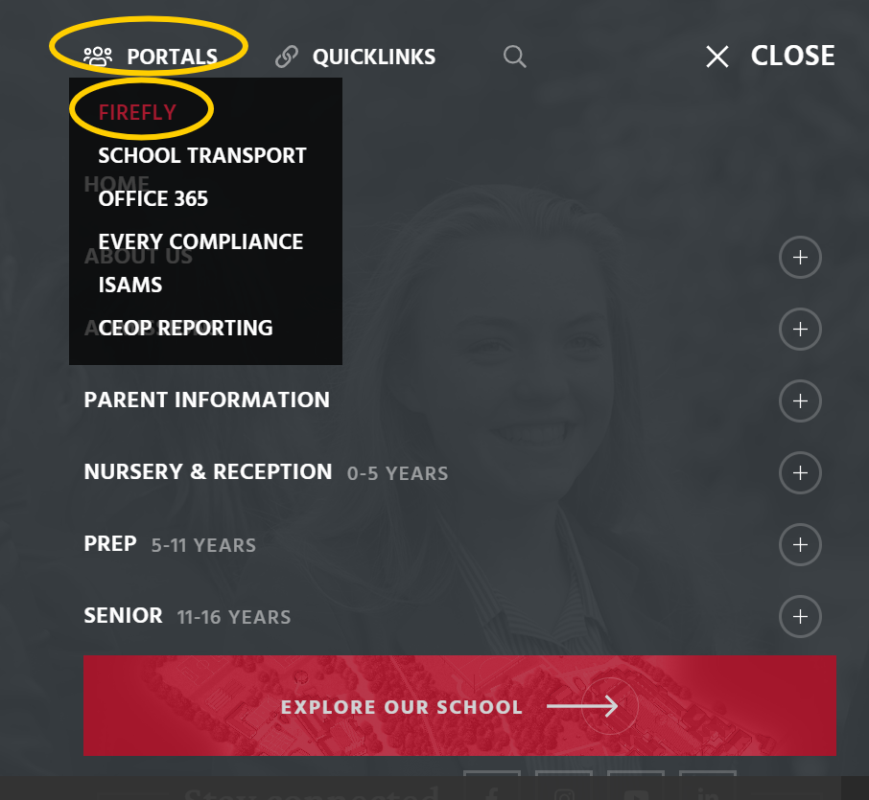
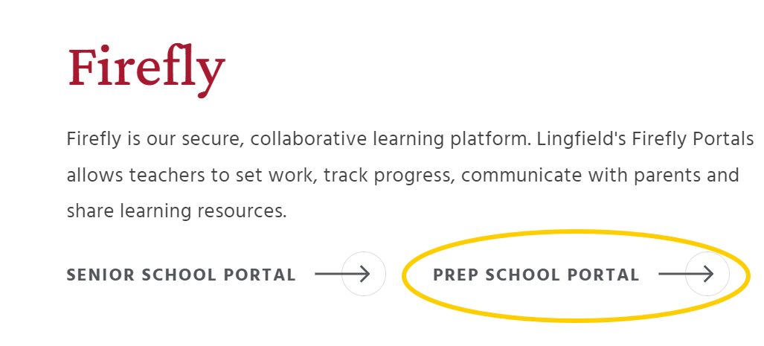
Firefly
To access Firefly, we recommend going through the school website.
Creating a bookmark or link on your computer or device would be useful too.
Warning: if you Google Lingfield College Firefly, this will automatically take you to the Senior Site. Current Prep parents and pupils cannot access this site until they are in the Senior School.

Slide 4
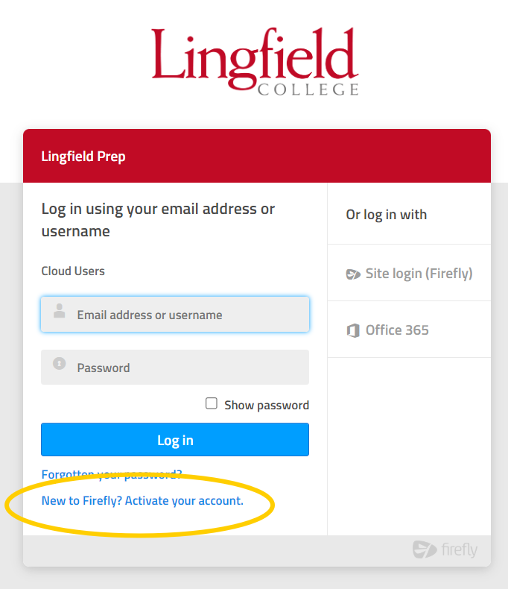
Parents
Before you use Firefly, you will need to create an account. This will need to be an email address you have access to and a password of your choice.
This will send an email to your chosen address – please check your spam folder if it does not arrive.
The email can take several minutes to come through.

Slide 5
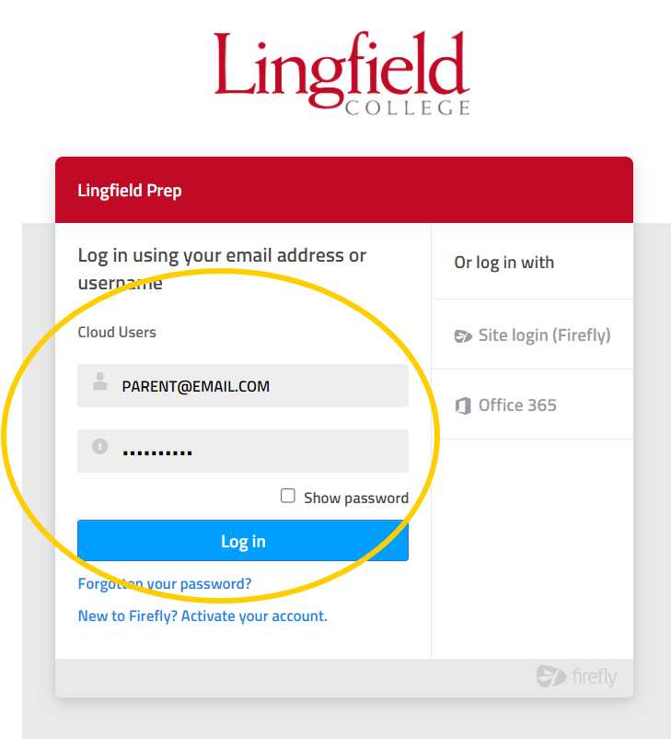
Parents
Once you have activated your account and followed the confirmation link on the email, you are now ready to use Firefly.
Each time, you will need to log in using the ‘cloud users’ option, with your details.

Slide 6
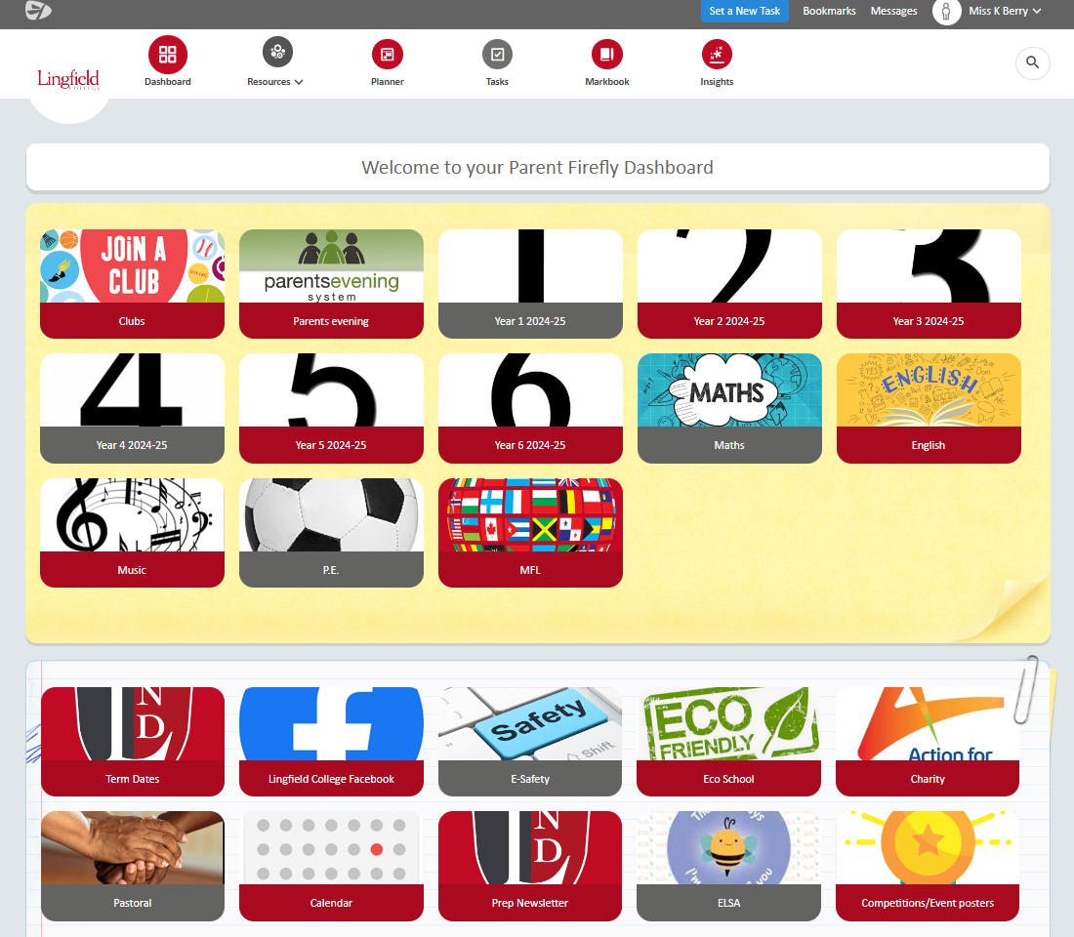
Parents
Once you have logged on, you will be brought to the Parent Dashboard.
This is similar to the Child Dashboard, but there are a few differences such as Parent’s evening access and Pastoral links and support.

Slide 7
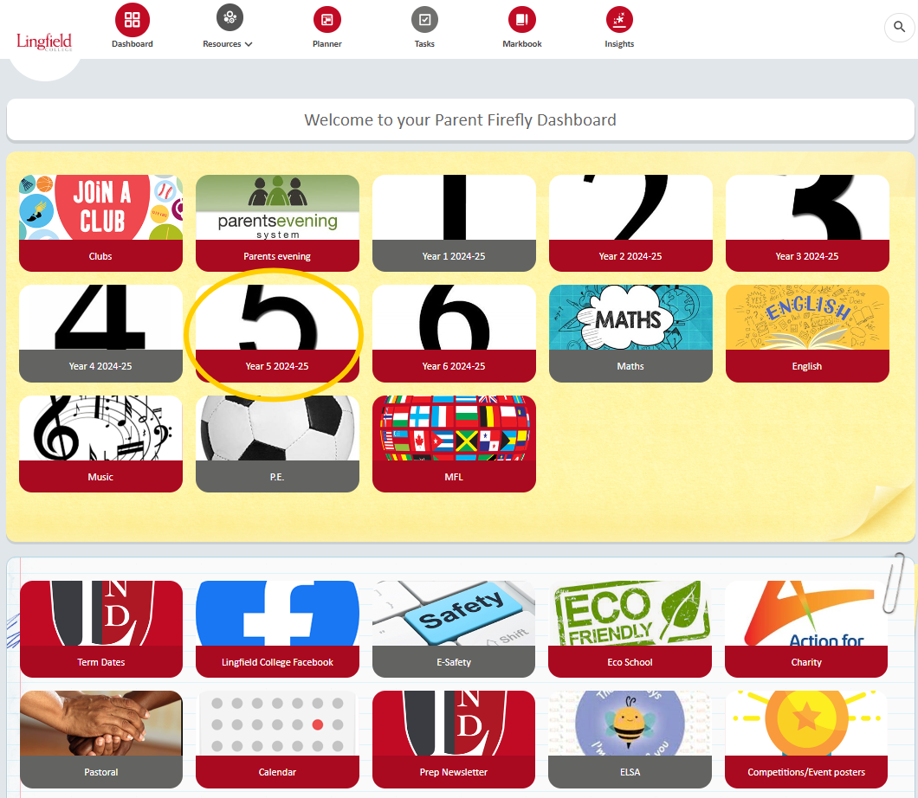
Parents
The most common features you will use relate to your child’s year group.
Please explore the rest of the dashboard, which includes information on current competitions, access to the newsletters, information on our charity and much more.

Slide 8
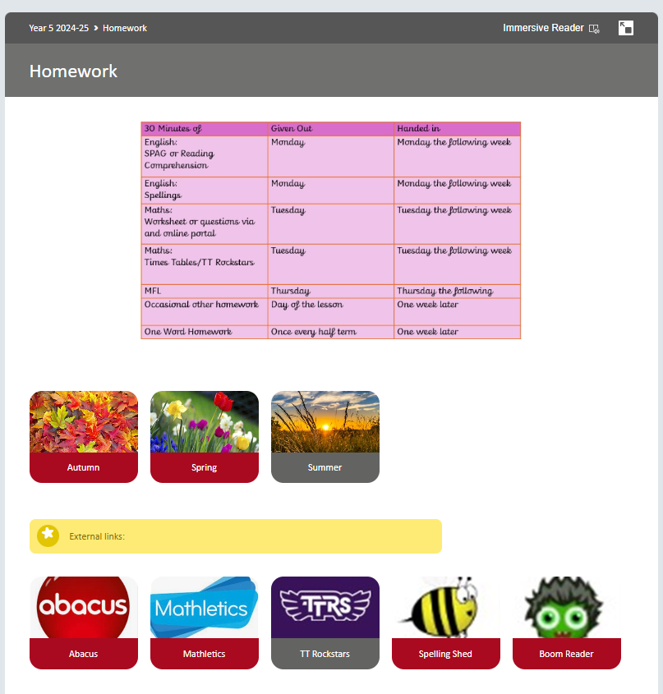
Parents
Everything you can see on your child’s year group page can be accessed from both ‘dashboards’.
We particularly encourage children in KS2 to check their homework themselves on Firefly as this will be the platform they are set assignments, tasks and notices in the Senior School.
The homework (and photos) are broken down to terms and then weeks and have links to regularly used external platforms and apps.

Slide 9
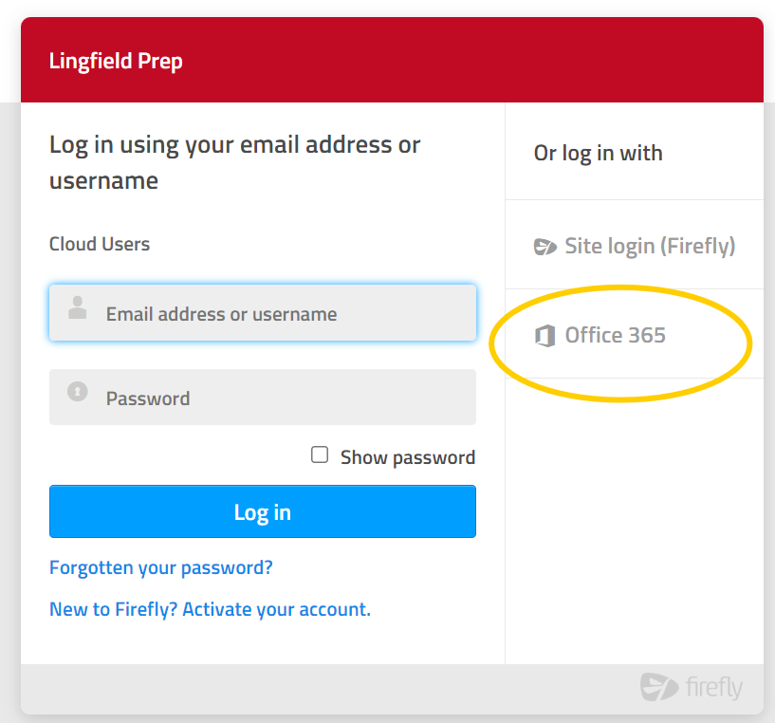
Pupils
When pupil’s login, they use the Office 365 button only.

Slide 10
Pupils
They then input their details with the following format:
25blogj@lingfieldcollege.co.uk
They then enter their 4-digit unique password (this is the same password they log on the school computers with)
Cohort number
First 4 letters of surname
Email address ending
First letter of first name

Slide 11
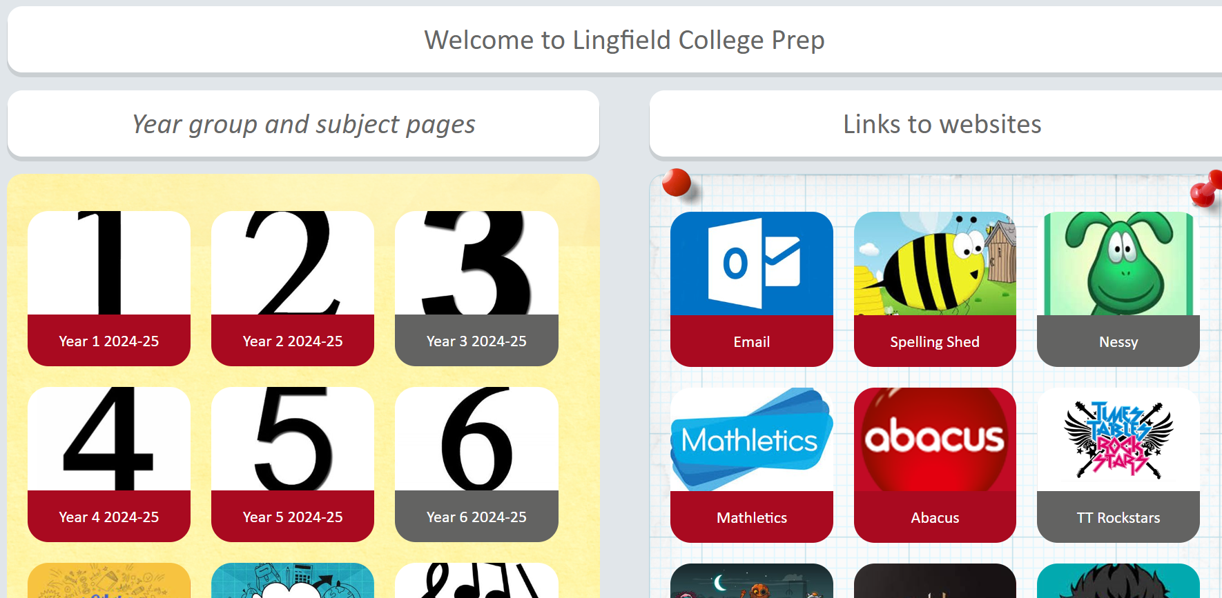
Pupils
The children’s view of Firefly is slightly different as it contains external app links on the right and has further buttons for Houses and subject pages.
If you have children in multiple Prep years, any child logged in can access any year group- you do not need to sign out and log in as each child.

Slide 12
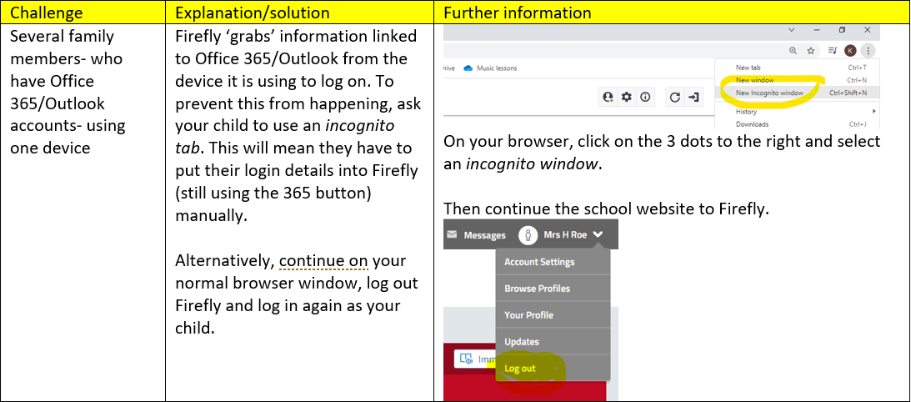
Troubleshooting

Slide 13
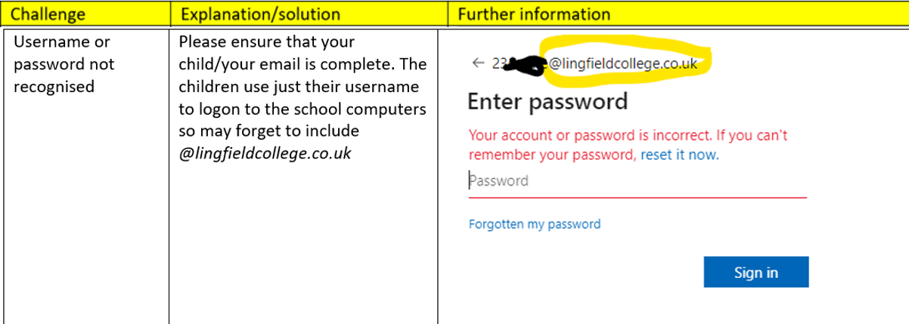
Troubleshooting

Slide 14
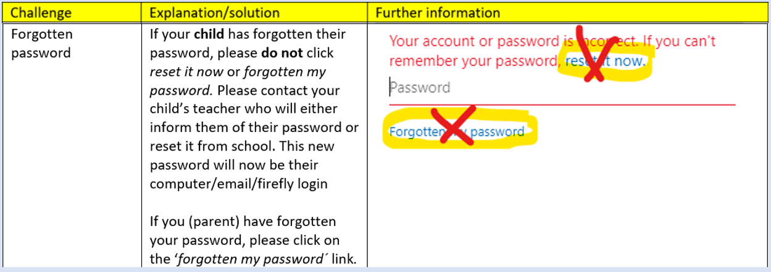
Troubleshooting

Slide 15
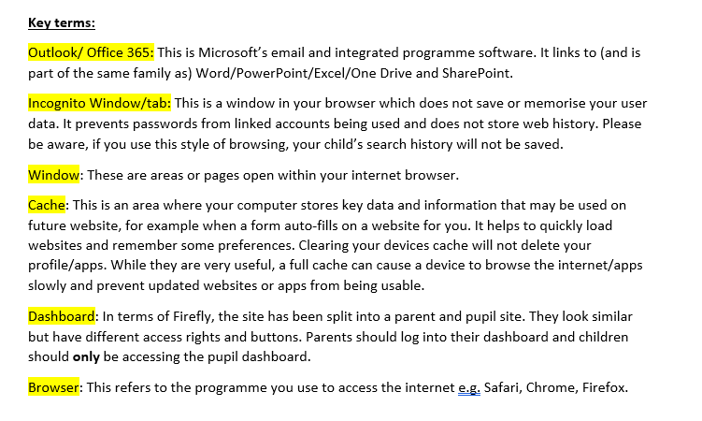
Troubleshooting

